Slide 1

Introduction to Linked Lists & Recursion in Python
Welcome to this foundational course on Data Structures and Algorithms! Today, we'll explore Linked Lists, a dynamic way to store data, and Recursion, a powerful programming technique. We'll use simple Python examples to build your understanding.

Slide 2
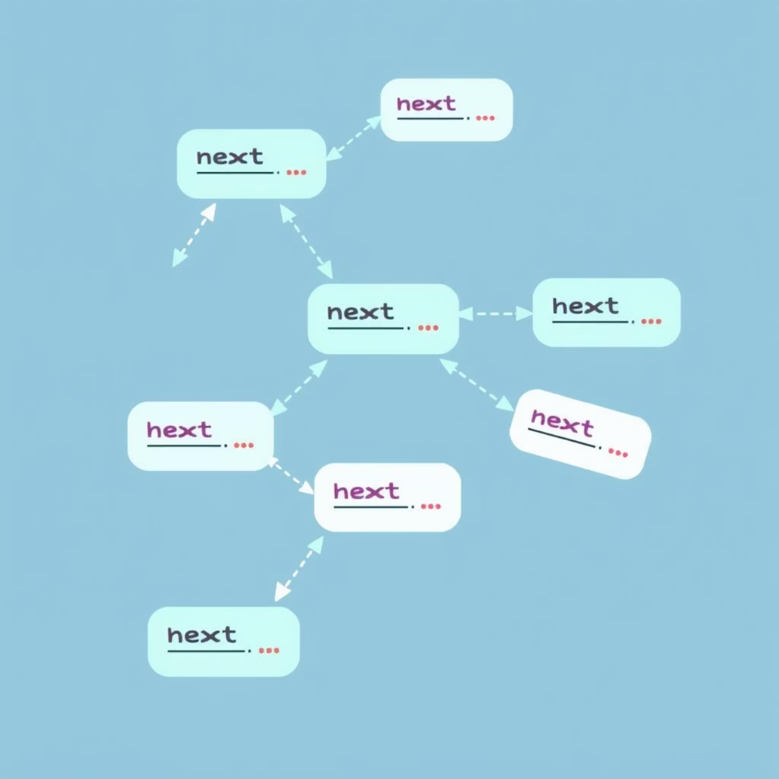
What is a Linked List?
Imagine a chain of paper clips, where each clip holds a piece of information and is linked to the next clip. That's essentially a Linked List!
It's a sequence of nodes, not stored together in memory like arrays.
Each node contains two parts: the actual data and a reference (or pointer) to the next node in the sequence.
The Head node is our starting point, and the very last node points to None, marking the end of the list.

Slide 3





Why Use Linked Lists?
Efficient Ins/Dels
Dynamic Memory
Adding or removing elements at the beginning or end is extremely fast, taking constant time (O(1)).
Unlike arrays, you don't need to pre-allocate memory. Nodes are created and linked as needed, saving space.
Flexible Structures
Unknown Size
They are fundamental building blocks for more complex data structures like stacks, queues, and even graphs.
Ideal when you don't know how much data you'll store or if the data size will frequently change.

Slide 4
Node Structure & Types of Linked Lists
Every node is a small container with two key parts:
Data: The actual value or information stored.
Next: A reference (or pointer) to the subsequent node in the list. If it's the last node, 'next' is set to None.
Singly Linked List
Nodes only point forward to the next element. Simple and most common.
There are different flavors of Linked Lists:
Doubly Linked List
Nodes point forward and backward, allowing traversal in both directions.
Circular Linked List
The last node's 'next' pointer links back to the head, forming a loop.

Slide 5




Basic Linked List Operations (Iterative)
Traversal
Insertion
Stepping through each node from head to tail to access its data.
Adding a new node at the beginning, end, or specific position.
Deletion
Search
Removing a node based on its value or its position in the list.
Finding a node that contains a specific piece of data within the list.

Slide 6
Introduction to Recursion
Self-Calling Function: Recursion is a programming technique where a function calls itself to solve a smaller version of the same problem.
Base Case: Every recursive function must have a "base case"—a condition that stops the recursion and prevents infinite loops.
Recursive Case: The part where the function calls itself with modified (usually simpler) input.
Natural Fit: Linked Lists, with their nested node structure, are naturally suited for recursive operations.

Slide 7
Recursive Linked List Operations
1
2
Recursive Traversal
Recursive Insertion
To print a list, print the current node's data, then recursively call the function on the 'next' node.
To add at the end, find the last node recursively, then attach the new node.
3
4
Recursive Length
Recursive Search
The length of a list is 1 (for the current node) plus the length of the rest of the list (calculated recursively).
Check the current node; if it's not a match, recursively search the 'next' node.

Slide 8

Python Code Examples: Linked List & Recursion
Let's dive into some practical Python code to bring these concepts to life! We'll walk through examples for:
Defining a Node class for Linked Lists.
Implementing basic iterative operations (traversal, insertion).
Showing how recursion works with simple functions.
Applying recursion to Linked List operations like calculating length or searching.

